Slide 1
Professional Practice of Education Assistants
What is Inclusive Education?

Slide 2

Checking In

Slide 3
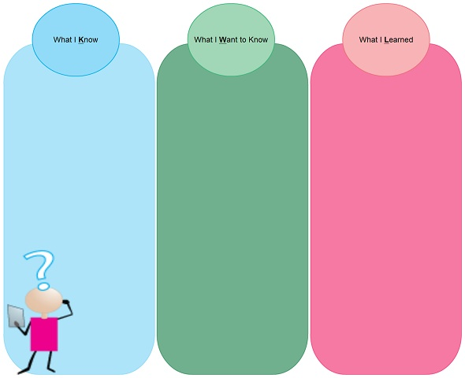

Activity: KWL
Complete chart on own
Put points up on chart paper
If your point is already up, put a check mark beside it

Slide 4
Inclusion: What is it?
A philosophy, a value, and a model
  A Philosophy: All members of a community should have equal opportunity to be involved / engaged in the life of the community
  A Value: We have a moral obligation not to discriminate, to care for all.
  A model: All children are included in the life of their home schools and grade level appropriate classrooms.

Slide 5

Inclusion is...
“…Everyone belongs, is accepted, supports, and is supported by his or her peers and other members of the school community in the course of having his or her educational needs met” (Stainback & Stainback, 1990, p. 3)

Slide 6

Inclusion is...
“…a value [that] supports the right of all children regardless of their diverse abilities to participate actively in natural settings in their community.” (Council for Exceptional Children, 1993)

Slide 7
Inclusion is...
“Inclusion is not a set of strategies or a placement issue. Inclusion is about belonging to a community – a group of friends, a school community, or a neighbourhood” (Allen & Schwartz, p. 4)

Slide 8

Inclusion is...
Inclusion is defined as the philosophy and practice of educating all students in regular classrooms, including those with the most significant disabilities. All students are valued for who they are and are seen as having potential to grow and develop academically and socially. Supports are provided to enable both students and teachers to be successful.

Slide 9

Activity: Inclusion Quotes
Work in dyads or triads.
Select a quote.
Fill in P.A.Y. chart
Discuss.

Slide 10

Inclusion is not...
Mainstreaming or integration
Segregated programs
Physical placement (proximity)
Placement with younger peers
So little involvement with teacher, peers or class that student is regarded as a “visitor”

Slide 11
Inclusion is not...
1:1 instruction or reliance on education assistants
Assuming that sitting quietly is an appropriate alternative to participation
Assuming the educators need little expertise or education to effectively support students
Working alone

Slide 12
Inclusion is not...
Relating only to adult support personnel
A program
A privilege
“Dumping” rather than planning
Underestimating the effectiveness of explicit instruction; focusing on activities rather than outcomes

Slide 13

Video clip
What new ideas about inclusion and / or the role of Education Assistant did you see? Add to your KWL chart.

Slide 14

Article: The Golden Rule

